Slide 1


Technical Writing and Presentation Introduction to Research Writing
TRƯỜNG ĐẠI HỌC BÁCH KHOA HÀ NỘI
HANOI UNIVERSITY OF SCIENCE AND TECHNOLOGY
SOICT - 2020

Slide 2
Contents
What is research?
Publication
Structure of a scientific paper
Coherence and cohesion
Variety and clarity
Common grammar and punctuation errors
Editing and proofreading

Slide 3
WHAT IS RESEARCH?

Slide 4
What is research?
“All truths are easy to understand once they are discovered;
the point is to discover them”
“And yet it moves”
Galileo Galilei
Notes:
Galileo Galilei (1564 – 1642) là một nhà vật lí, nhà toán học và nhà thiên văn học nổi tiếng, người đóng vai trò quan trọng trong cuộc Cách mạng khoa học. Các thành tựu của ông gồm những cải tiến cho kính thiên văn và các quan sát thiên văn sau đó. Galileo đã được gọi là "cha đẻ của quan sát thiên văn học hiện đại", "cha đẻ của vật lý hiện đại", và "cha đẻ của khoa học hiện đại"

Slide 5
What is research?
“The best way to predict the future
is to invent it”
Alan Kay
Computer Scientist
Notes:
Kay tham gia thiết kế mạng ARPAnet, tiền thân của mạng Internet. Ông cũng là người chế tạo Dynabook, phiên bản đầu tiên của dòng máy tính xách tay hiện nay, với màn hình phẳng, mạng không dây và trang bị bút điện tử. Bên cạnh đó, Alan Kay còn cộng tác với Steve Jobs và các đồng nghiệp tại hãng Apple Computer (trước đây) để tạo ra Macintosh, chiếc máy tính đầu tiên có giao diện đồ họa thân thiện với người dùng được sản xuất hàng loạt.
Kay là người đưa ra thuật ngữ lập trình hướng đối tượng

Slide 6
What is research
Cambridge dictionary
a detailed study of a subject, especially in order to discover (new) information or reach a (new) understanding
Research Whisperer
Research is defined as the creation of new knowledge and/or the use of existing knowledge in a new and creative way to generate new concepts, methodologies and understandings

Slide 7
PUBLICATION

Slide 8
Publication in Computer Science
You need publish your work to the world
If people don’t know about it, they won’t use it
Increase probability of adoption
Requirements of writing
Standard form, structure
Good content, style, organisation
Requirements of quality
a valid publication, published in the right place like in peer-reviewed journals, conferences
contain results with sufficient information to enable (i) assess, (ii) repeat experiments

Slide 9
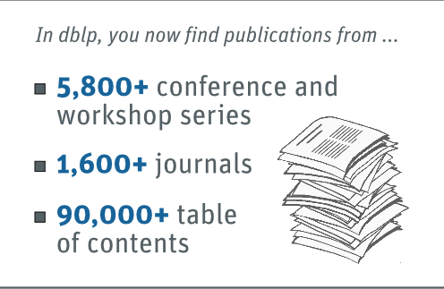
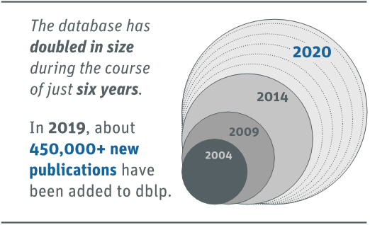
Publication in Computer Science
Number of publications
Source: DBLP

Slide 10

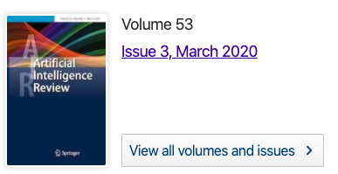
Publication in Computer Science
Kinds of scientific publication: book, dissertation, conference proceedings, journal article, etc.
book
conference proceedings
dissertation
journal

Slide 11
Publication in Computer Science
Book: most often a monograph written by specialist(s), reviewed by experts, focuses on a specific topic
Dissertation: scientific work of Phd students
Conference proceedings: a collection of papers, posters presented at a conference
Journal article: final “extened version” of a conference paper

Slide 12
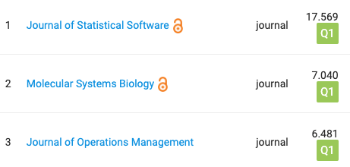
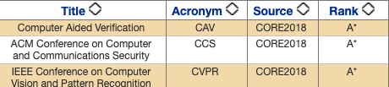
Publication in Computer Science
Conference paper
Journal article
Have page limits
Provide higher visibility and greater impact
More timely
High requirement of novelty
Unlimited/longer page limits
Opportunity to revise and re-submit paper for review
Longer review
Require 30% content to be new, compared to eariler conference version

Slide 13
Publication in Computer Science
Ranked publications
Scimago - Journals: https://www.scimagojr.com/journalrank.php?area=1700
CORE - Conferences: http://portal.core.edu.au/conf-ranks/
List of Call for papers: http://www.wikicfp.com/cfp/
Researchers’ publications: https://dblp.uni-trier.de/pers, https://scholar.google.com/

Slide 14
STRUCTURE OF A SCIENTIFIC PAPER

Slide 15
Structure of a scientific paper
Three core parts in a paper: introduction, body, and discussion
Introduction: general motivations and research problems
Body: research methods and results in detail
Discussion: general conclusions and implications from the results
Additional parts: title, abstract, references, appendix, acknowledgment

Slide 16
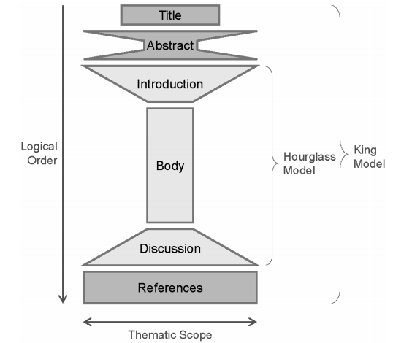
Structure of a scientific paper
Parts in a paper
Source: Michael Derntl, Basics of research paper writing and publishing, Int. J. Technology Enhanced Learning, Vol 6, No. 2, 2014

Slide 17
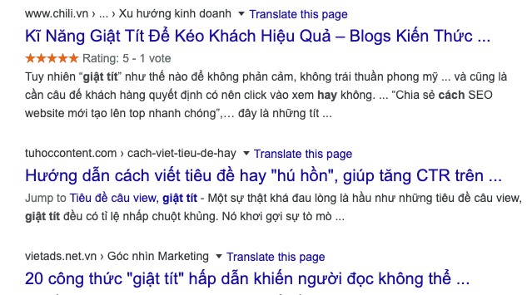
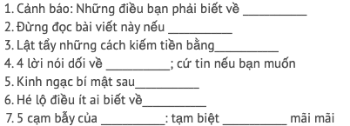
Title
read first and most often
good title “the fewest possible words that adequately describe the contents of the paper”
identify the main issue of the paper
accurate, unambiguos, specific, and complete
do not contain abbreviations unless they are well known e.g., HTML, CPU
attract readers
ways to attract Vietnamese news readers
J4F

Slide 18
Title – Different types
Descriptive titles: describe what the paper is about
Investigating the role of academic conferences on shaping the research agenda
Declarative titles: make a statement about the results presented in the paper
Academic conferences shape the short-term research agenda
Interrogative titles: pose a question
Do academic conferences shape the research agenda?
Compound titles: combined approach
Do academic conferences shape the research agenda? An empirical investigation

Slide 19
Title – Examples
Review some examples belows:
‘Educational Technology and Culture: The Influence of Ethnic and Professional Culture on Learners’ Technology Acceptance’
‘HT06, tagging paper, taxonomy, Flickr, academic article, to read’
‘A New Framework for Dynamic Adaptations and Actions’
‘Go To Statement Considered Harmful’
Notes:
‘Educational Technology and Culture: The Influence of Ethnic and Professional Culture on Learners’ Technology Acceptance’: a compound, mostly descriptive title, which is relatively long with 15 words. Despite its length, it does not reveal the findings of the study.
‘HT06, tagging paper, taxonomy, Flickr, academic article, to read’: an interesting variant of a descriptive title that is self-reflective. The paper is about tagging, published at the Hypertext conference in 2006 (HT06) and it uses a list of tags as its title including a reference to the conference. Due to its unusual style, it will probably stand out in a table of contents and thus attract readers.
‘A New Framework for Dynamic Adaptations and Actions’: a descriptive title that reveals only little about the content of the paper. Moreover, it is fairly unspecific by not clarifying what kinds of adaptations and actions are dealt with. Unless this is clear in the target community, the title should include some declarative pieces (e.g. what characteristics does the framework expose other than that it is ‘new’?)
‘Go To Statement Considered Harmful’: a declarative, short title, which will be rather meaningless to non-computer scientists. This is the title of an influential paper published by Edsger Dijkstra in 1968, and the style of the title referring to a common practice that is suboptimal as being ‘considered harmful’ has since been adopted for many other papers.

Slide 20
Abstract
One-paragraph summary of the whole paper
Two types of abtract
Informative abstract: extracts everything relevant from the paper, an aggregated substitute for the full paper
Descriptive abstract: describe outline of the paper
Checklist
Motivation: why do we care the problem and results?
Problem: what problem that the paper is trying to solve
Solution: what was done
Results: what is the answer to the problem
Implications: what does the answer imply?

Slide 21
Abstract - Example
Paper interfaces for learning geometry
Unsupervised auto-tagging for learning object enrichment
Motivation
Problem
Solution
Results
Implications
Motivation
Problem
Solution
Results
Implications

Slide 22
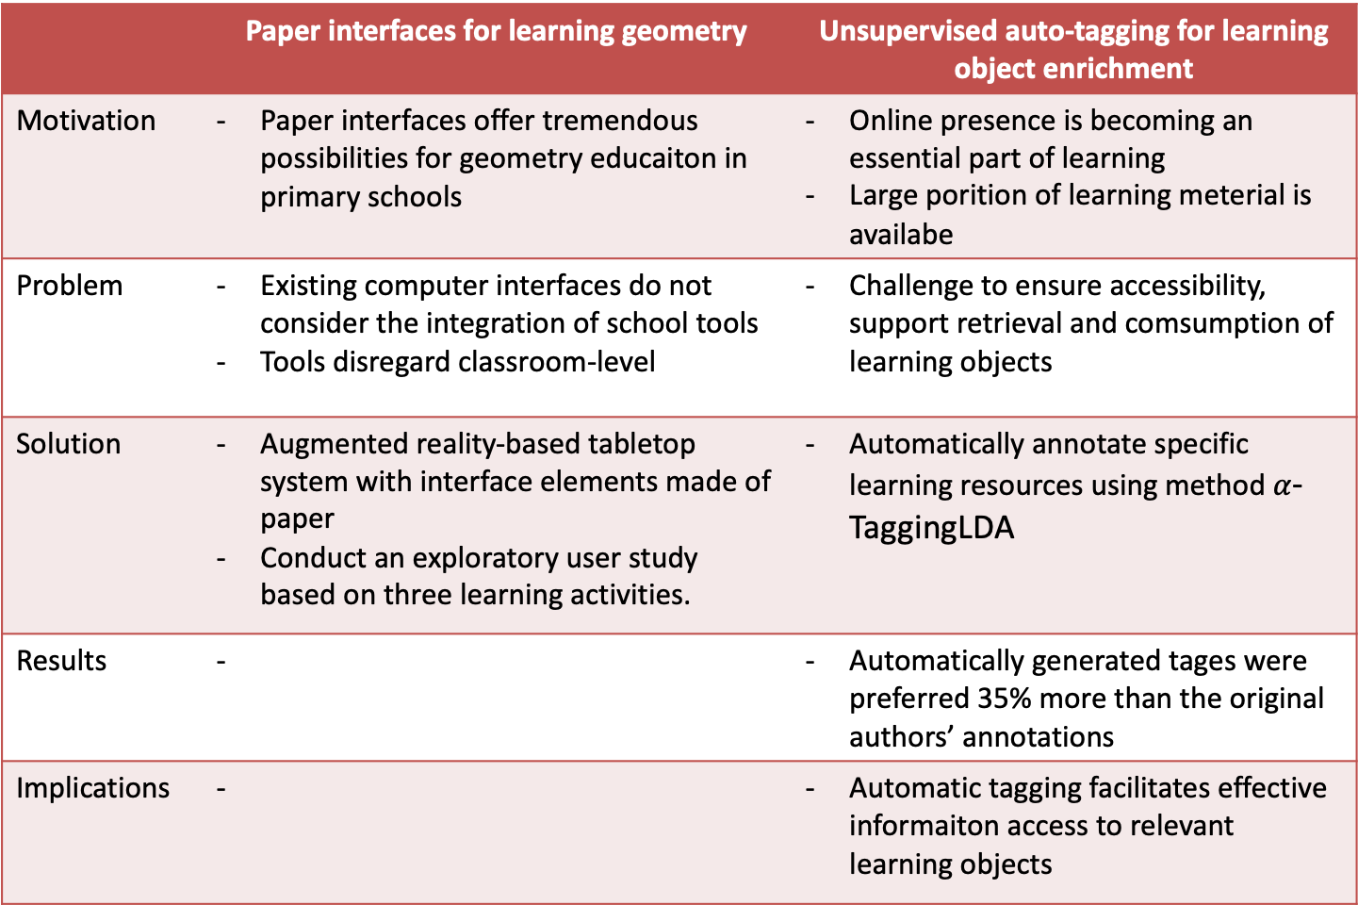
Abstract - Example
 | Paper interfaces for learning geometry | Unsupervised auto-tagging for learning object enrichment
Motivation | Paper interfaces offer tremendous possibilities for geometry educaiton in primary schools | Online presence is becoming an essential part of learning Large porition of learning meterial is availabe
Problem | Existing computer interfaces do not consider the integration of school tools Tools disregard classroom-level | Challenge to ensure accessibility, support retrieval and comsumption of learning objects
Solution | Augmented reality-based tabletop system with interface elements made of paper Conduct an exploratory user study based on three learning activities. | Automatically annotate specific learning resources using method $α$-TaggingLDA
Results | - | Automatically generated tages were preferred 35% more than the original authors’ annotations
Implications | - | Automatic tagging facilitates effective informaiton access to relevant learning objects

Slide 23
Introduction
Leads the reader from a general subject area to a particular field of research
Three phrases
Establish a territory: point out the importance of the subject, present an overview on current research
Establish a niche: oppose an existing assumption or reveal a research gap or formulate a problem
Occupy the niche: sketch the intent of own work and/or outline important characteristics of the work, important results

Slide 24
Body
Answers two questions:
How was the research question addressed?
What was found?
Comprise serveral sections, subsections
Example
Empirical paper: describes material, data used for the study, methodology and results obtained
Case study paper: describles the application of existing methods, theory, or tools.
Theory paper: describes principles, concepts, models on which work is based

Slide 25
Discussion
Other terms: Discussion and Conclusion, Conclusion, etc.
Contains
Background information of the research aim
Brief summary of the results
Comparision of results with previously published work
Conclusions or hypothesis drawn from the results
Outlook on future work

Slide 26
References
Cite related work at the end of the paper
Many formats/styles for citing a paper, and listing references
Some common styles
Name and year system: e.g., Chuck and Norris (2003) define...
Alphabet-number system: As reported in [4],...
Citation order system: similar to the alphabet-number system with one difference, i.e., references in the order of apperance in the text
Two rules
Every cited sources must be listed
Every listed sources must be cited

Slide 27
COHERENCE AND COHESION

Slide 28
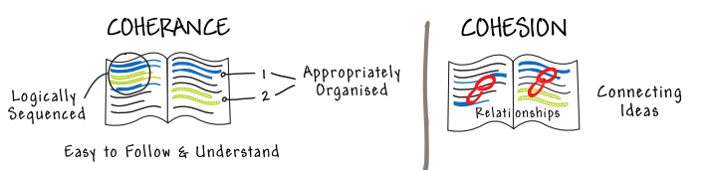
Coherence and Cohesion
Vital feature of writing in order to enhance reader’s understanding of text
Coherence
Connection of ideas at the idea level
Refers “rhetorical” aspect of writing which includes developing arguments, organizing and clarifying ideas
Cohesion
Connection of ideas at the sentence level
Focuses on “grammatical” aspect of writing
Source: British coucil - IELTS
Notes:
rhetorical: hùng biện

Slide 29
Cohesion - Approaches
Repetition: use a particular word/phrase arcross different sentences
E.g.,
Of course, materials development or adaptation is not the only priority for the professions in South Africa. However, the focus on materials development is appealing because it provides a very tangible and practical focus for speech and language therapists (Pascoe et al., 2013).

Slide 30
Cohesion - Approaches
Synonyms: use a word/phrase which has a similar meaning to a keyword in the first sentence
E.g.
The purpose of population genetics is to quantify and explain the processes generating variation in natural populations (Vargo & Husseneder, 2011). Sociogenetic studies of eusocial insects are generally based on the approach that the colony functions as a discrete entity within the population (Thorne et al., 1999).

Slide 31
Cohesion - Approaches
Pronous: use a pronoun to refer back to a word/phrase already used
E.g.
When scientific experiments do not work out as expected, they are often considered failures until some other scientist tries them again. Those that work out better the second time around are the ones that promise the most rewards.

Slide 32
Cohesion – Cohesive Words/Phares
Additive words: Also, and, as well as, at the same time as, besides, equally important, further, furthermore, in addition, likewise, moreover, too, not only... but also.
Amplification words: As, for example, for instance, in fact, specifically, such as, that is, to illustrate
Repetitive words: Again, in other words, that is, to repeat
Contrast words: But, conversely, despite, even though, however, in contrast, notwithstanding, on the one hand / on the other hand, still, although, though, whereas, yet, nevertheless, on the contrary, in spite of this

Slide 33
Cohesion – Cohesive Words/Phares
Cause and effect words: Accordingly, as a result, because, consequently, for this reason, since, as, so, then, therefore, thus
Qualifying words: Although, if, even, therefore, unless
Example: For example, for instance
Emphasizing words: Above all, more/most importantly
Reason words: For this reason, therefore

Slide 34
Cohesion – Cohesive Words/Phares
Order words: At the same time, firstly, secondly, lastly, next, today/yesterday/next year, then, until, while, in the end, eventually
Explanation: in other words, that is to day
Attitude: Of course, fortunately, unfortunately, certainly
Summary: finally, in conclusion, in short, to summaries

Slide 35
Cohesion - Example
The hotel is famous. It is one of the most well-known hotels in the country. The latest international dancing competition was held at the hotel. The hotel spent a lot of money to advertise the event. Because the hotel wanted to gain international reputation. But not many people attended the event.
The hotel, which is one of the most well-known hotels in this region, wanted to promote its image around the world by hosting the latest international dancing competition. Although the event was widely advertised, not many people participated in the competition.
The latest international dancing competition was held at the hotel, which is one of the most well-known hotels in this region. The hotel spent a lot of money on advertising the event since it wanted to enhance its international reputation; however, it failed to attract many people.
Notes:
Example 1: the connection of ideas is not very good
Example 2, 3: the connection of ideas is better

Slide 36
Coherence
Combincation of every paragraph, every sentence, and every phrase to contribute to the meaning of the whole text
Two factors: paragraph unity and sentence cohesion
Paragraph unity:
Paragraph must have a topic sentence
Every other sentence in the body (i) contains more specific information than the topic sentence and (ii) maintains the same focus of attention as the topic sentence

Slide 37
Coherence - Example
Paragraph:
As a reminder, please promptly return the lecture notes you borrowed. Slide the notes under my door if I am not there. I may become agitated if you are late, much like my Uncle Chester after several eggnogs on Christmas Eve. Most Christmases I liked to stay up and open my stockings after midnight. Staying up late was exciting and would be repeated a week later at New Year’s. So would Uncle Chester’s disgraceful behavior.
Cohesion: ?
Coherence: ?
Notes:
The passage is cohesive.
• Each sentence connects with the next and the previous.
• Sentences begin with familiar information.
• Sentences end with new information.
But the passage is not coherent.
• The topic of each sentence is different from the previous.
• Thus, the paragraph lacks focus.

Slide 38
VARIETY AND CLARITY

Slide 39
Variety and Clarity
Paper containing sentences of one short patterns bores both reader and writer
Repetition of simple sentence pattern draws attention to itself, not the ideas
Simple or short sentences cannot show many relationships among the ideas
Should revise the sentences to express the ideas more clearly and add variety to the paper
Notes:
Clarity: rõ ràng

Slide 40
Variety and Clarity
Do adjacent sentences contain the same subject and/or the same verb? If yes, combine them in a single, concise sentence
Join sentences by omitting a repeated subject (1)
Original: Radio advertisements are broadcast daily or weekly. Radio advertisements reach a wide audience.
Revision: Radio advertisements are broadcast daily or weekly and reach a wide audience.

Slide 41
Variety and Clarity
Do adjacent sentences contain the same subject and/or the same verb? If yes, combine them in a single, concise sentence
Join the sentences by omitting repeated subjects and verbs and by using adjectives (2)
Original: The city council conducted a study of public transportation. The study was lengthy. The study was detailed.
Revision: The city council conducted a lengthy, detailed study of public transportation.

Slide 42
Variety and Clarity
Do adjacent sentences contain the same subject and/or the same verb? If yes, combine them in a single, concise sentence
Join the sentences by omitting repeated subjects and verbs and by using adverbs (3)
Original: the negotiators worked to gain approval for the contract. The negotiators worked at a steady pace. However, they worked slowly.
Revision: The negotiators worked steadily but slowly to gain approval for the contract.

Slide 43
Variety and Clarity
Do adjacent sentences contain ideas of equal importance? If yes, use coordination
Using comma: combines with seven types of conjunctions
and/in addition/along with shows addition: The strike divided the town, and it strained labor-management relations.
but/however/except/on the other hand shows contrast: Negotiators resolved the strike, but the town remained divided.
for/because/the reason shows reason: Coping with environmental issues is a necessary part of industrial studies, for industries affect the environment.

Slide 44
Variety and Clarity
so/as a result/therefore shows logical consequence: Industries affect the environment, so coping with environmental issues is a necessary part of industrial studies.
nor shows addition of a negative point: The environment cannot sustain constant resource depletion, nor can it recover quickly from wide-scale resource extraction.
or shows choice: Businesses can design their own programs for recording statistical data, or they can use purchased, pre-designed programs.
yet shows contrast: More secondary schools are implementing programs designed to increase teenagers' awareness of the dangers of drinking and driving, yet alcohol-related traffic accidents continue to be one of the leading causes of death for people between the ages of fifteen and twenty-two

Slide 45
Variety and Clarity
Do adjacent sentences contain ideas of equal importance? If yes, use coordination
Using semicolon: when you want to keep two closely related ideas in one sentence
however/but: The actress's performance electrified the audience; however, lighting and sound problems diminished the play's overall impact.
furthermore: The project required extensive research; furthermore, budget cuts reduced the available funds.

Slide 46
Variety and Clarity
instead/rather: Neither bold colors nor heavy lines made the painting striking; instead, the sheer size of the canvas drew attention.
consequently/as a result: The speech required preparation and an in-depth analysis of the situation; consequently the student surveyed the population on the issue.
nevertheless/however: The recently established bio-social theory helps us see the evolution of human behavior with a new perspective; nevertheless, few scientists endorse it.

Slide 47
Variety and Clarity
Do adjacent sentences contain ideas of unequal importance? If yes, use subordination
when, until, after, as soon as, before, ever since, as, while show a relation that indicates time:
Original: The two countries reached an agreement on trade policies. They then were able to complete their peace treaty.
Revision: After the two countries reached an agreement on trade policies, they were able to complete their peace treaty.
because, since show a relation that indicates causality
Original: The statistics in the proposal were inaccurate. It was this that made the proposal fail.
Revision: The proposal failed because its statistics were inaccurate.

Slide 48
Variety and Clarity
though, although, even though, while express concession and contrast of ideas
Original: Equipment failures and labor strikes delayed the submarine's completion. Naval engineers continued the project.
Revision: Although equipment failures and labor strikes delayed the submarine's completion, naval engineers continued the project.
of, as if, provided that, unless, as though show condition
Original: Video game manufacturers plan to impose a rating system to indicate violence. The ratings system will be ineffectual without an accompanying plan for reinforcement.
Revision: Unless video game manufacturers issue an accompanying plan for enforcement, their ratings system will be ineffectual.

Slide 49
Variety and Clarity
where indicates place
Original: The male hornbill builds a nest for his mate. He chooses a nest site that will protect her and her chicks from predators.
Revision: The male hornbill builds a nest for his mate where she and her chicks will be protected from predators.
so that shows result
Original: The author wanted people of all income levels to be able to read her book. To achieve this, she stipulated that the book be sold for under five dollars.
Revision: So that people of all income levels would be able to read her book, the author stipulated that the book be sold for under five dollars.

Slide 50
Variety and Clarity
whichever, whenever, wherever, whoever indicate general possibility
Original: The program's format allows individual users to make changes. This can be done each time users encounter problems in implementing the program.
Revision: The program's format allows individual users to make changes whenever they encounter problems implementing the problem.
more, less than shows comparison of ideas
Original: The beginner's manual contains few technical terms. However, the advanced manual contains several.
Revision: The advanced manual contains more technical terms than the beginner’s manual.

Slide 51
Variety and Clarity
who, whom, whose, that: persons
Original: Peter Tchaikowsky, a Russian composer, lived from 1840 to 1893. He composed Peter and the Wolf.
Revision: Peter Tchaikowsky, a Russian composer who lived from 1840 to 1893, composed Peter and the Wolf.

Slide 52
Variety and Clarity
that, which: things
Original: Peter and the Wolf is often performed for audiences of children. The composition uses different instruments to represent different characters.
Revision: Peter and the Wolf, which uses different instruments to represent different characters, is often performed for audiences of children

Slide 53
Variety and Clarity
which: explanatory clause
Original: The judges scored the performances using a new set of standards. This different method of scoring resulted in unanticipated victories for several new competitors.
Revision: The judges scored the performance using a new set of standards, which resulted in unanticipated victories for several new competitors.

Slide 54
Variety and Clarity
where: place; when: time
Original: A press conference is an ideal place to find out information. Many journalists meet, discuss, and question current political issues at a press conference.
Revision: a press conference where many journalists meet, discuss, and question current issues, is an ideal place to find out information.

Slide 55
COMMON GRAMMAR AND PUNCTUATION ERRORS

Slide 56
Common grammar and punctuation errors
Subject – Verb agreement errors
Example 1:
Incorrect: An important part of my life have been the people who stood by me
Correct: An important part of my life has been the people who stood by me.
Example 2
Incorrect: A huge number has been asked here
Correct: A huge number have been asked here
The number: singular, a number: plural
Example 3
Incorrect: Each of the women in the class were nurses
Correct: Each of the women in the class was nurse
Notes:
A number: plura

Slide 57
Common grammar and punctuation errors
2. Miss comma after introductory element
Example 1:
Incorrect: In case you haven’t noticed my real name doesn’t appear in the article.
Correct: In case you haven’t noticed, my real name doesn’t appear in the article.
Example 2
Incorrect: Before she had time to think about it Sharon jumped into the icy pool.
Correct: Before she had time to think about it, Sharon jumped into the icy pool.
Notes:
A comma should be used after an introductory word, phrase, or clause. This gives the reader a slight pause after an introductory element and often can help avoid confusion.

Slide 58
Common grammar and punctuation errors
3. Misusing its and it’s
Example 1:
Incorrect: I don’t believe its finally Friday
Correct: I don’t believe it’s (it is) finally Friday.
Example 2
Incorrect: The cat was licking it’s tail.
Correct: The cat was licking its tail.
Notes:
A comma should be used after an introductory word, phrase, or clause. This gives the reader a slight pause after an introductory element and often can help avoid confusion.

Slide 59
Common grammar and punctuation errors
4. Ambiguous pronoun reference
Example 1:
Incorrect: When Jonathan finally found his dog, he was so happy. (The dog or Jonathan?)
Correct: Jonathan was so happy when he finally found his dog.
Example 2
Incorrect: Don felt a lot of anger and bitterness as a result of Marie’s decision. This is what ended everything. (What ended everything? Don’s anger and bitterness or Marie’s decision?)
Correct: Don felt a lot of anger and bitterness as a result of Marie’s decision. Her choice ended everything.
Notes:
A comma should be used after an introductory word, phrase, or clause. This gives the reader a slight pause after an introductory element and often can help avoid confusion.

Slide 60
Common grammar and punctuation errors
5. Lack of parallel structure
Example 1:
Incorrect: He wanted to learn more about careers in programming, engineering, biochemist, and research scientist.
Correct: He wanted to learn more about careers in programming, engineering, biochemist, and researching scientist.
Example 2
Incorrect: The key directives of his boss were clear:
Meet monthly sales quotas.
Aggressive marketing techniques.
Reporting in every day.
Correct: The key directives of his boss were clear:
Meet monthly sales quotas.
Aggressive marketing techniques.
Report in every day.
Notes:
Faulty parallelism occurs when two or more parts of a sentence are similar in meaning but not parallel (or grammatically similar) in form. It often occurs with paired constructions and items in a series.

Slide 61
Common grammar and punctuation errors
6. Daling modifier: the intented subject or the modifier is missing from the sentence, an instead another subject appears in its place
Example 1:
Incorrect: While driving to work, a car accident was witnessed on the highway.
Correct: While driving to work, Jane witnessed a car accident on the highway.
Example 2:
Incorrect: Having finished the assignment, the TV was turned on
Correct: Having finished the assignment, Jill turned on the TV.

Slide 62
Common grammar and punctuation errors
6. Daling modifier – Revise the following sentences:
Having arrived late for practice, a written excuse was needed.
Without knowing his name, it was difficult to introduce him.
To improve his results, the experiment was done again.
Notes:
Having arrived late for practice, the team captain needed a written excuse.
Because Maria did not know his name, it was difficult to introduce him.
He improved his results by doing the experiment again.

Slide 63
Common grammar and punctuation errors
7. The Oxford comma
The comma before the final item in a list: standard in Bristish writing
US writing: skip the last comma, especially in journalism
It’s a matter of preference, no right or wrong when it comes to the Oxford comma
Example:
Oxford comma: My favorite foods are pizza, spaghetti, and steak
without Oxford comma: My favorite foods are pizza, spaghetti and steak
Notes:
Faulty parallelism occurs when two or more parts of a sentence are similar in meaning but not parallel (or grammatically similar) in form. It often occurs with paired constructions and items in a series.

Slide 64
EDITING & PROOFREADING

Slide 65
Editing and proofreading strategies
Same: both demands close and careful reading
Different: two different stages of the revision stage, using different techniques
General strategies
Get some distance from the text
Find a quiet place to work
Try chaning the look of the document
Use ruler or page, card to read line by line

Slide 66
Editing
Begin as soon as you finish the first draft
Reread the draft to see whether the paper is well organized, the tranistion between paragraphs are smooth, etc.
Edit on several levels
Content:
Have you done everything the assignment/goal requires?
Are the claims make accurate?
Is all information in your paper relevant to the assignment/goal?
Have you supported each point with adequate evidence?

Slide 67
Editing
Edit on several levels
Overall structure:
Does your paper have an appropriate intro and conclusion?
Is it clear how each paragraph in the body is related to the goal?
Are the paragraphs arraged in a logical sequence?
Have you made clear transitions between paragraphs?
Structure within paragraphs?
Does each paragraph have a clear topic sentence?
Does each paragraph stick to one main idea?
Are there any extraneous or missing sentences in any paragraphs?

Slide 68
Editing
Edit on several levels
Clarity
Is the meaning of each sentence clear?
Is it clear what each pronoun (he, she, it, they, etc.) refers to?
Have you chosen the proper words to express your ideas?
Have you defined any important terms that might be unclear to reader?
Style
Have you used an appropriated tone (formal, informal, etc.)?
Have you varied the length and structure of sentences?
Do you tends to use the passive voice too much?

Slide 69
Editing
Edit on several levels
Citations
Have you appropriately cited quoted, paragraphs, ideas you got from sources?
Are your citations in the correct format?
After editing at all levels, you make significant revisions to the content and wording of the paper
Check pattern of error you tend to have for correcting future instances

Slide 70
Proofreading
The final stage of the editing process
Only after you have finished all of your other editing revisions
Focus on surface errors such as misspelling, mistakes in grammar and punctuation

Slide 71
Proofreading
Don’t rely entirely on spelling checkers because they are far from foolproof.
Proofread for only one kind of error at a time
Read slow, and read every word
Separate the text into individual sentences
Circle every punctuation mark
Read the paper backwards: useful for checking spelling
Ignorance may be bliss, but it won’t make you a better proofreader. If you’re not sure about something, look it up.

